Slide 1
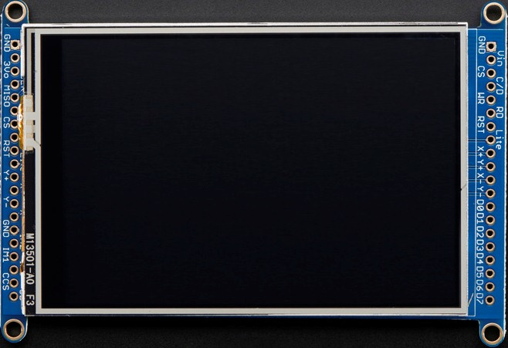
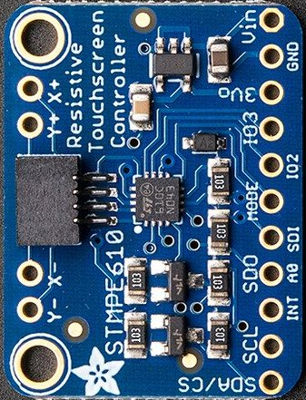
Touch Screen Rotation 0º
Adafruit HXD8357D 3.5" 320x480 Color TFT Touchscreen Breakout
Adafruit STMPE610 Resistive Touch Screen Controller
STMPE610 - TFT
Y- = Y-
X- = X-
Y+ = Y+
X+ = X+
4095, 4095
0, 0
X = 0 – 4095
Y = 0 – 4095
Z = 0 – 255 (presure)

Slide 2
Touch Screen Rotation 90º
Adafruit HXD8357D 3.5" 320x480 Color TFT Touchscreen Breakout
Adafruit STMPE610 Resistive Touch Screen Controller
STMPE610 - TFT
Y- = Y-
X- = X+
Y+ = Y+
X+ = X-
0, 0
4095, 4095
X = 0 – 4095
Y = 0 – 4095
Z = 0 – 255 (presure)

Slide 3
Touch Screen Rotation 180º
Adafruit HXD8357D 3.5" 320x480 Color TFT Touchscreen Breakout
Adafruit STMPE610 Resistive Touch Screen Controller
STMPE610 - TFT
Y- = Y+
X- = X+
Y+ = Y-
X+ = X-
0, 0
4095, 4095
X = 0 – 4095
Y = 0 – 4095
Z = 0 – 255 (presure)

Slide 4
Touch Screen Rotation 270º
Adafruit HXD8357D 3.5" 320x480 Color TFT Touchscreen Breakout
Adafruit STMPE610 Resistive Touch Screen Controller
STMPE610 - TFT
Y- = Y+
X- = X-
Y+ = Y-
X+ = X+
4095, 4095
0, 0
X = 0 – 4095
Y = 0 – 4095
Z = 0 – 255 (presure)

Slide 5
